Slide 1
Welcome to extreme-event monitoring: Using social media for actionable extreme weather event surveillance
#ExtremeEvents, #SevereWeather. Natural phenomena that generally occur over very short time scales of hours to days to weeks. Extreme events include tropical cyclones (hurricanes, typhoons), tornadoes, floods, heat and cold waves, wildfires, earthquakes, tsunamis, and volcanic eruptions.
Twitter Map

Slide 2
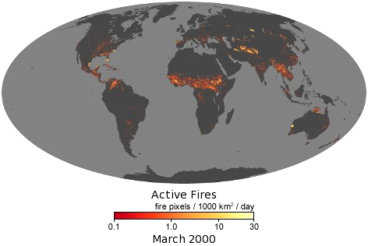
#Wildfires, #Fires
On Earth, something is always burning. Wildfires are started by lightning or accidentally by people. Fires can generate large amounts of smoke pollution, release greenhouse gases, and unintentionally degrade ecosystems. But fires can also clear away dead and dying underbrush, which can help restore an ecosystem to good health.
Twitter Map
Source: https://earthobservatory.nasa.gov/

Slide 3
#Hurricane. A large rotating storm with high speed winds that forms over warm waters in tropical areas.
Twitter Map
Source: National Hurricane Center

Slide 4
#Flood A large rotating storm with high speed winds that forms over warm waters in tropical areas.
Twitter Map
Source: National Hurricane Center

